Slide 1

Has 2020 become a…
YEAR of Reckoning: COVID-19 ?
Notes:
We’ve collected some data to help us answer these questions.

Slide 2
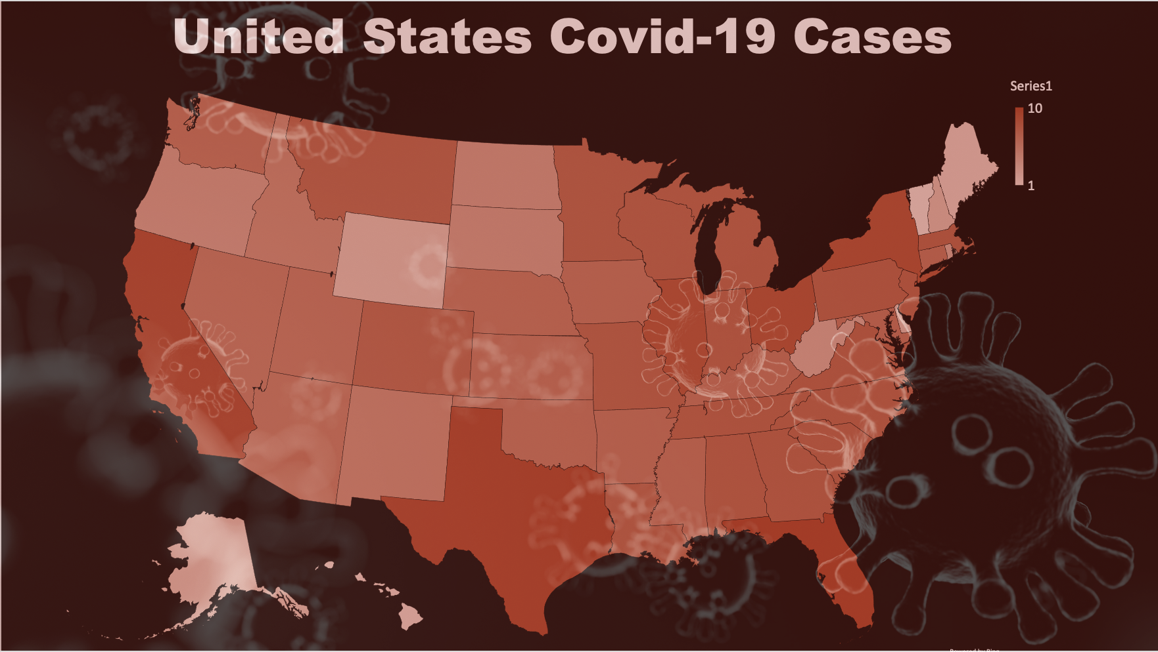
Car manufacturers live and die on consumer sentiment and the consumers’ ability to buy a car.
In 2019 the U.S. had record low unemployment, robust consumer sentiment, and low interest rates. For most, the economy was thriving.
2020 brought COVID-19 and with it a change in public policies. Businesses were shuttered. Unemployment hit record highs. Consumer sentiment plummeted along with interest rates.
Let’s take a look at how auto manufacturers fared and how their sales changed.
Covid-19 and its effect on new car sales.
Notes:
Car manufacturers live and die on consumer sentiment and the consumers’ ability to buy a car.
In 2019 the U.S. had record low unemployment, robust consumer sentiment, and low interest rates. For most, the economy was thriving.
2020 brought COVID-19 and with it a change in public policies. Businesses were shuttered. Unemployment hit record highs. Consumer sentiment plummeted along with interest rates.
Let’s take a look at how auto manufacturers fared and how their sales changed.

Slide 3
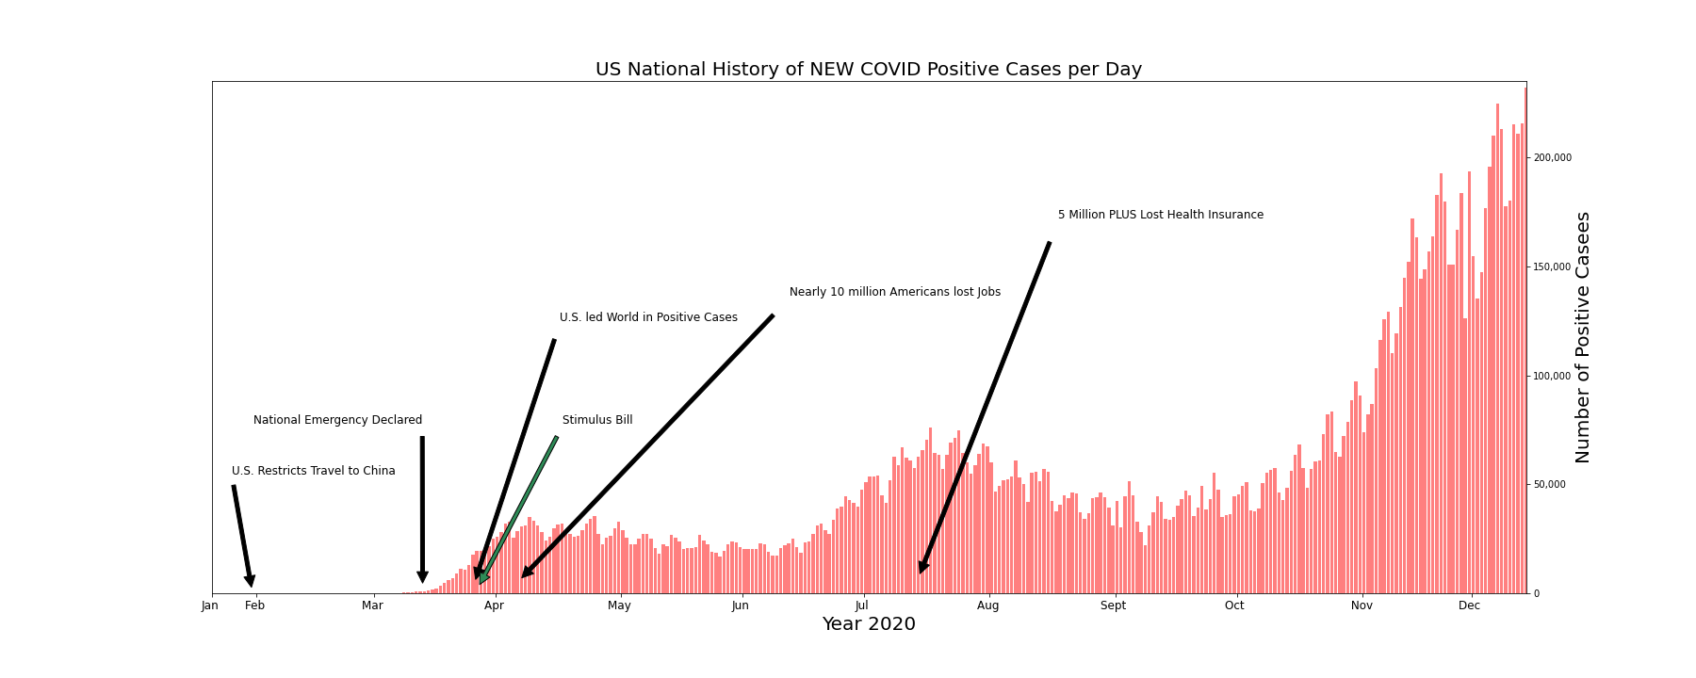
232,105
57,603
17,734
28,045
13,949
0
https://covidtracking.com/data/api
Notes:
During the eve of the new year 2020, January becomes a significant month because the US restricts travel to China to prevent a deadly virus from spreading to our shores. This is the lowest point in the bar graph for 0 positive covid-19 cases for the U.S.
In March there were three significant events:
The President declares a National Emergency, The U.S. led the world in confirmed cases with 17,734 positive covid-19 cases for the day, and Trump signed a stimulus bill into law..
In April - Millions lost their jobs …the question for many…Will I be able to afford food, rent, mortgage, the basic necessities, much less a car?
The bar graph illustrates a roller coaster of positive increase cases per day…reaching a peak in mid April and July. At the end of September there is an increase of cases per day for the U.S. leading to a subsequent spike (CLICK-MOUSE) of the last day recorded for this project – December 11, 2020, for the staggering number of one-day positive cases of 232,105.
And STILL have we reached a Peak? (CLICK-MOUSE)

Slide 4
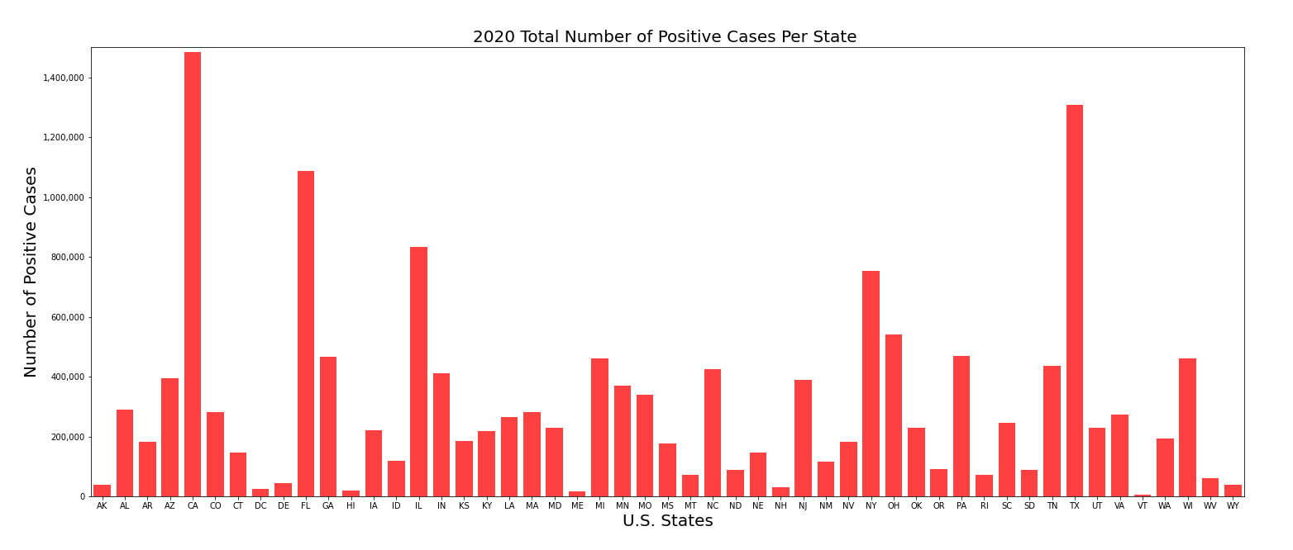
California
Texas
Florida
…And our National story is still unfolding…
take a look at the number of cases per state.
https://covidtracking.com/data/api
Notes:
…And our National story is still unfolding…take a look at the number of cases per state. (CLICK-MOUSE)
Heavily populated states like California, Florida, and Texas, surpass the ONE Million mark for the year…and closely following are states like Illinois and New York. (CLICK-MOUSE)

Slide 5

General Conditions

Slide 6
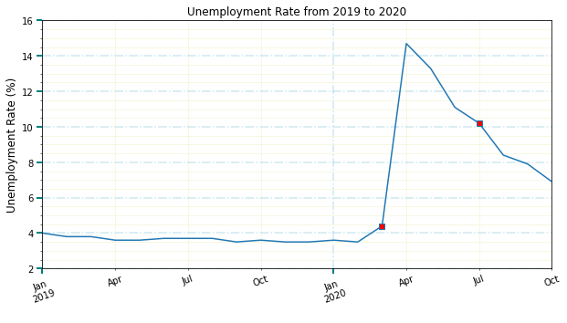

Slide 7
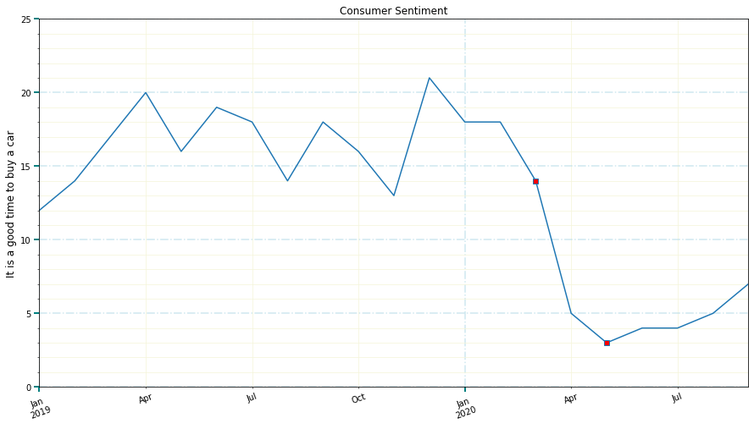

Slide 8
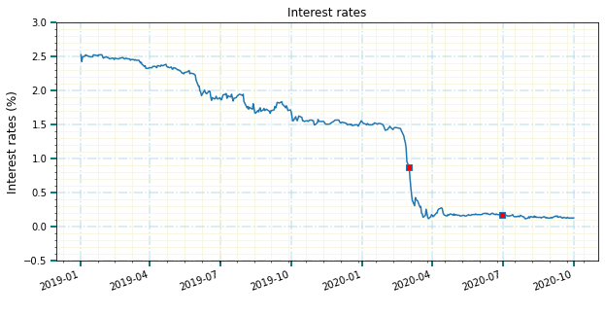

Slide 9

18% : Average sales decline
Effect on Car Sales

Slide 10
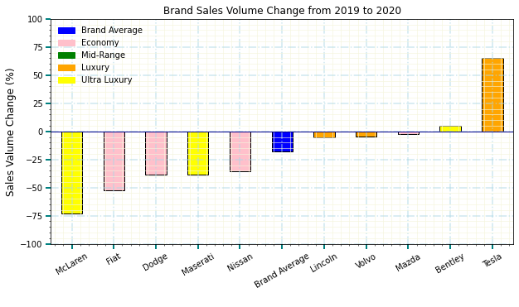

Slide 11
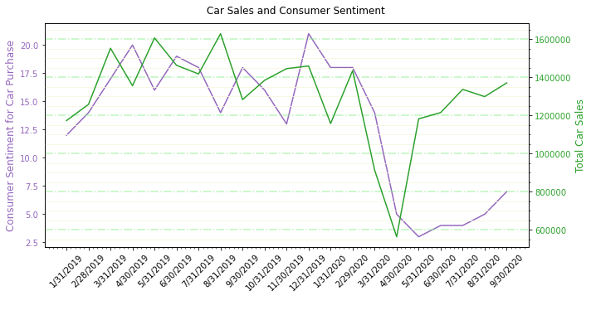

Slide 12
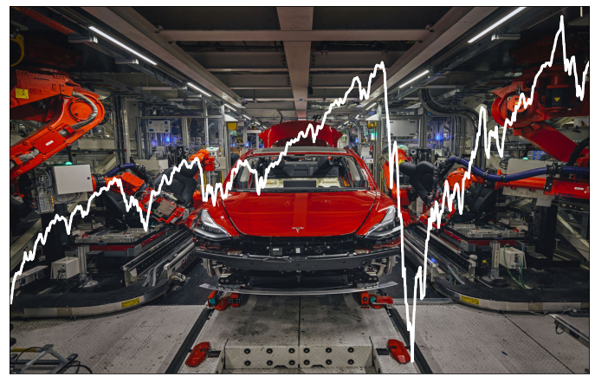
Retail investors have accounted for as much as 25% of the stock market's activity amid coronavirus-driven volatility.
Effect on the Stock Market

Slide 13
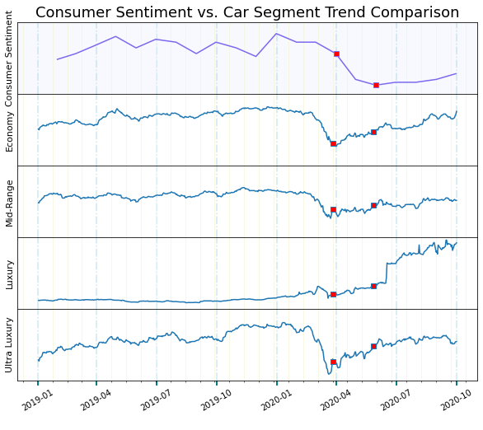
Consumer
Sentiment
vs
Auto
Segment
Index Stock
Prices

Slide 14
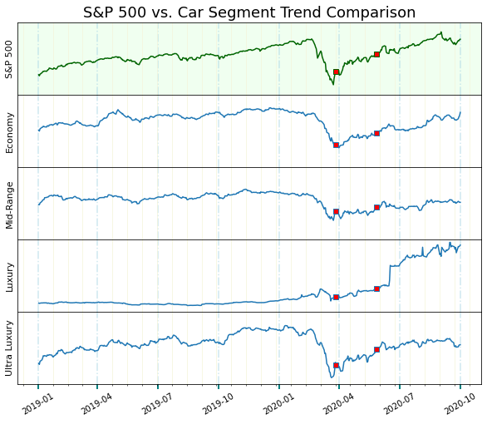
S&P 500
vs Auto Segment Index Stock Prices

Slide 15
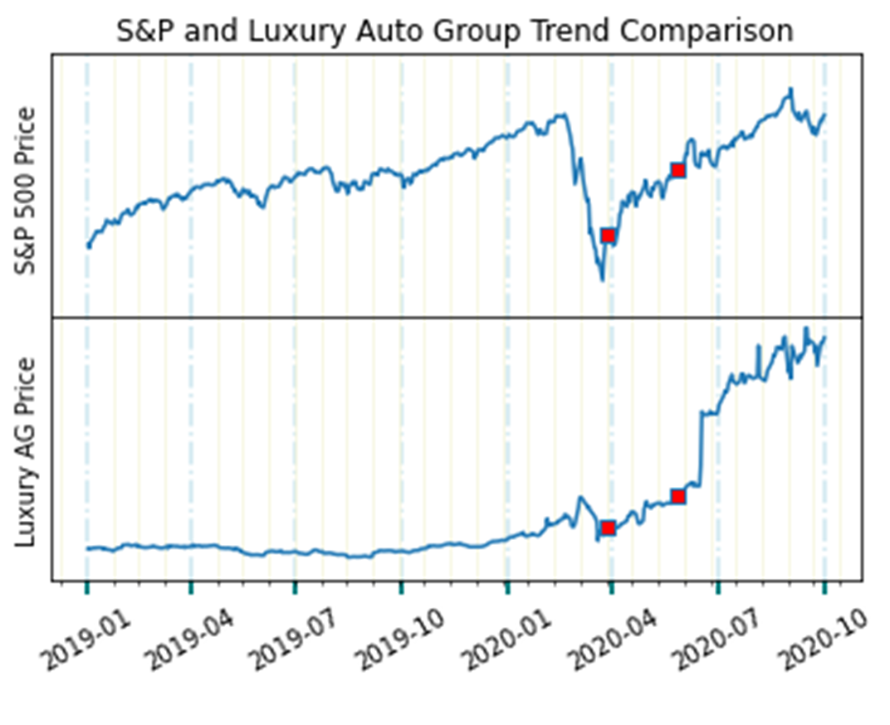
S&P 500 Index
vs
Luxury AG Index
Tesla sales fueled the rise of their stock price and drove the luxury index from flat performance to outpacing the S&P.
Notes:
Luxury Auto Groups like Mercedes and BMW initially look like nothing stood in the way of luxury cars rolling into consumers’ garages... but this is misleading.
Tesla sales skyrocketed their stock price and drove the luxury index from flat performance to outpacing the S&P. While relatively flat throughout 2018 and 2019 TSLA stock has increased in value ten times over in 2020. This has dominated the index and other broad economic factors (though a flattening in the slope is observed in April through June).

Slide 16
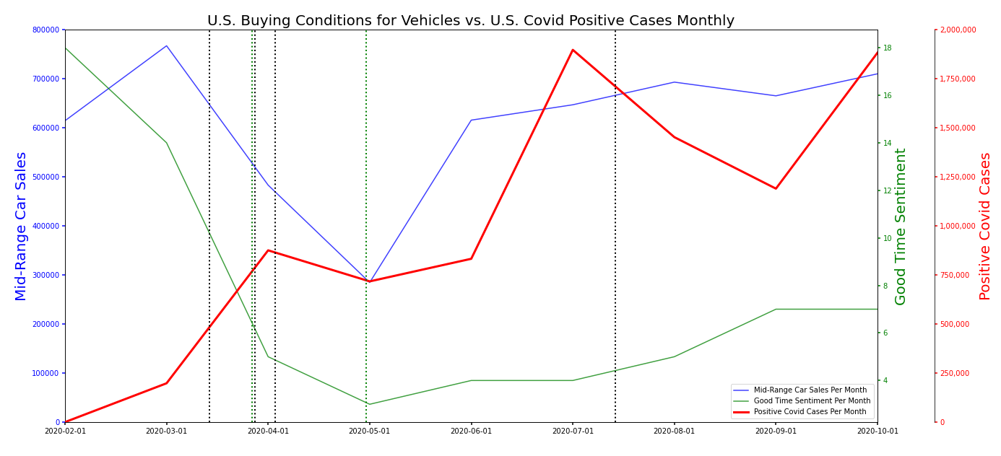
https://www.quandl.com/data/UMICH/SOC38-University-of-Michigan-Consumer-Survey-Reasons-for-Opinions-for-Buying-Conditions-for-Vehicles
https://covidtracking.com/data/api
Notes:
To better understand if COVID-19 has affected the U.S. Car Industry…let’s dive deeper …
This is a line graph illustrating three lines that show the U.S. Buying Conditions for Vehicles/ Mid-Range Car Sales versus U.S. Covid-19 Positive Cases Per Month
The dotted BLACK vertical lines represent historical markers: U.S. National Emergency Declaration, U.S. Leading the World in Positive Cases, more than 10 million Americans are unemployed,
The dotted Green vertical lines represent historical markers: when the first Stimulus Bill was Signed and when Airlines announced rules requiring face masks.
The date range is through February to October 2020.
(CLICK-MOUSE)
The red line, representing the monthly # of Covid Cases has an upward trend with two major peaks in April and July.
(CLICK-MOUSE)
The green line, representing the monthly # of consumer sentiment for the buying conditions of vehicles, demonstrates a significant decrease from February to May and slightly less dramatic increase from May to October.
(CLICK-MOUSE)
The blue line, represents the monthly Mid-Range Car Sales. In early March, begins a fall in car sales for Mid-Range cars. Then a sharp increase from May to June. The line seems to increase a bit until August with a slight decrease until September.
There are two observations here that are evident and that these three lines appear to have some correlation. As the RED Covid-19 line trend increases: Consumer Sentiment decreases without gaining back much what it has lost from the original high point of 18. The U.S. Consumer sentiment is low because times are hard due to the hardships instigated by COVID-19. The second observation represented here is that the Blue Mid-Range car sales line seem to parallel with the Green Consumer Sentiment line. It appears that both decrease and increase at the same points in time.
Nationally Historic events due to COVID-19, have influenced Consumer Sentiment for Buying Vehicles such as Mid-Range Cars.

Slide 17
Summary/data methodology
Possible Data limitations:
Covid data could be inaccurate due to governments poor reporting methodology
Financial analysis as objective price, etc.
Consumer Sentiment is not an ‘objective’ data but a ‘feeling’ survey.

Slide 18




Team 6 Analysts
Luis Fernando Ruiz delves into government data and highlights what we need to know.
Team 6 Analytical Group uses data to explain how world and national events affect the financial markets.
Contact us for your next research project.
Phillecia Qualls is our automotive sector guru and keeps an eye on who is in front of the pack and who has been left on the side of the road.
Methodology
Data is sourced from best known origin.
Data cleaned including tasks like removing null values, changing data type and removing unnecessary rows and columns
Calculations are made
Indexes are composed
Visualizations created
Karen Pearson is our healthcare sector guru and offers us a prognosis of the factors and the players in this space.
Dana Woodruff tracks the stock market’s reactions to news and events… what happened and why.

Slide 19
Data sources: Https://www.Truecar.Com/prices-new https://global.Toyota/en/ir/library/sec/ https://www.Fcagroup.Com/enus/investors/financial_regulatory/pages/latest_financial_results.Aspx https://www.Treasury.Gov/resource-center/datachartcenter/interestrates/pages/textview.Aspx?Data=billratesyear&year=2020 https://www.Quandl.Com/data/UMICH/soc38-university-of-michigan-consumer-survey-reasons-for-opinions-for-buying-conditions-for-vehicles https://covidtracking.Com/data/api https://www.Bls.Gov/charts/employment-situation/civilian-unemployment-rate.Htm https://markets.Businessinsider.Com/news/stocks/retail-investors-quarter-of-stock-market-coronavirus-volatility-trading-citadel-2020-7-1029382035#:~:text=retail%20investors%20now%20account%20for,the%20market's%20trades%20in%202019. Https://www.Goodcarbadcar.Net/ https://www.Volkswagenag.Com/presence/investorrelation/publications/interimreports/2020/q3_2020_e.Pdf
https://www.nytimes.com/article/coronavirus-timeline.html

